Slide 1
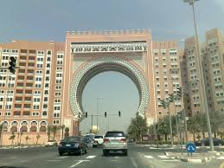
Ibn Battuta Mall

Slide 2
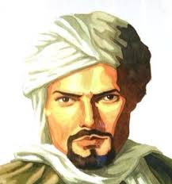
The mall is like a museum!
Each region Ibn Battuta went to has a mall court – Andalusia, Tunisia, Egypt, Persia, India and China
(February 25, 1304 – 1368 or 1369)

Slide 3
