Slide 1
LSC0209 – A2 - List 7 – S2
Missing Words - Choices

Slide 2
Sections 1-3
married
aunt
uncle
singer
cousin
grandaughter
grandparent

Slide 3
Sections 4-6
sky
clear
cloud
farmer
few
dry
moon

Slide 4
Sections 7-8
boss
partner
secretary
laugh
repeat
meeting
surname
manager

Slide 5
Sections 9-10
building
gate
club
hobby
swimming

Slide 6
Sections 11-12
copy
copy
card
copy
file
file

Slide 7
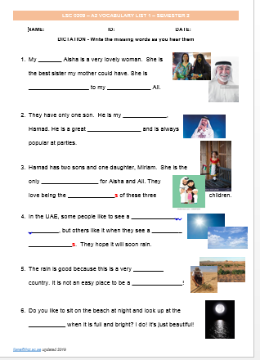
GOOD LUCK!
Study these words for next week’s quiz!

